Slide 1
Multi-Agent Reinforcement Learning for Robust and Scalable Failure Root-Cause Analysis
Christopher Aust, Ulrike Bath, Florence Boettger, Jonas Krah
March 30th, 2022
Master Project WiSe 21/22

Slide 2
Agenda
Motivation
State of the Art
Approach
Experiments
MAPE-K Robustness
Failure Propagation Robustness
Scalability
Extensions
Threats to Validity
Conclusion & Future Work
Notes:
Story (Experiment, Result, Discussion)

Slide 3
Motivation

Slide 4
Motivation
Problem Statement
The real world is constantly evolving
?
Current systems cannot adapt to these complex and changing environments
Inability to adapt is a problem of lack of robustness in these AI Systems [Jordan 2019][D’Amour et al. 2020]
Train the model to learn
Notes:
Even though of the many breakthroughs in AI development, in practice, these systems often cannot be deployed because of the constant changes in the real-world.
It is most probably that current systems cannot adapt to more complex and evolving realities due to their lack of robustness.
So instead of training a model to an environment, we should train the model to learn and adapt to these changes.

Slide 5
Motivation
Context
Context: E-commerce platform for online shops
States/Observations: Component failure modes
Actions: Self-Repair and Self-Optimization
Goal: Fix the failing component
Problem: State ≠ Observation Lack of robustness
Notes:
Therefore, we picked a simple use case to develop a fitting architecture:
An e-commerce platform for online shops where a shop’s services called components can fail and have to be fixed.
However, the state is not necessarily the observation, because of noise or malfunctioning sensors.
humans cannot be asked to solve this problem of robustness by monitoring and analysing data (too slow)
not scalable b/c of constantly evolving environment
That is why have to train the models effectively.

Slide 6

Motivation
Phenomenon
Human-driven data
Behavioral Contagion: tendency for people to repeat behavior after others have performed it [Schmidt 21]
Recurring Events / Behavior [Folwarczny 22]
⟳
[Schmidt 2021] Purchasing under threat: Changes in shopping patterns during the COVID-19 pandemic. PloS one
[Folwarczny 2022] Viral Viruses and Modified Mobility: Cyberspace Disease Salience Predicts Human Movement Patterns
Notes:
Models are meant to learn from data and adapt to certain circumstances and conditions.
However, many models are directly linked to real-world conditions in such a way that drastic changes in behavior and rules will mess with the outcome.
This is why, we should also take a closer look into human behavior.
There we saw especially in the last years the behavorial contagion:
The tendency for people to repeat behavior after others have performed it.
This also affects how people use distributed systems that support activities from personal finances and medical care to travelling and and shopping.
During the pandemic, major spikes in consumption caused by panic buying and supply hoarding, starring toilet paper and alcohol, lead to demand forecasting models losing it completely.
Panic buying spread across Hong Kong and spread to countries including Singapore, and Australia, the US, the UK,
Events, especially drastic events, mean consumer habits have, and will continue to, change.
But it can also mean that previous behavior might recur,
for example the panic buying of sunflower oil now.
We will keep this phenomenon in mind in our robustness approach.
Schmidt, S., et al.. (2021). Purchasing under threat: Changes in shopping patterns during the COVID-19 pandemic. PloS one, 16(6),
Folwarczny, M., et al. (2022). Viral Viruses and Modified Mobility: Cyberspace Disease Salience Predicts Human Movement Patterns.

Slide 7
State of the Art

Slide 8
State of the Art
Reinforcement Learning
Deep Q-Learning (DQN) [Mnih 13]
Proximal Policy Optimization (PPO) [Schulman 2017]
Deep DQN (DDQN) [Timothy 19]
Advantage Actor-Critic (A2C) [Sutton 18]
Notes:
Reinforcement learning (RL) is a machine learning method where an agent independently learns a strategy to minimize the cumulative regret by choosing action according to their immediate and discounted cumulative rewards.
This way, the agent learns independently in which situation which action is the best.
Unlike supervised learning, RL does not require data up front.
Instead, the database is formed through extensive trial-and-error runs within a simulation scenario.
Here is an overview of popular state-of-the-art RL approaches.
The Deep Q-Learning is a simple and very commonly used model.
The network is trained with a variant of the Q-learning algorithm, with stochastic gradient descent to update the weights.
An approximate approach can be realized with the Proximal Policy Optimization model, an algorithm with high data efficiency and a reliable performance.
The Deep DQN is based on the DQN, but decouples the estimation into an actor-critic architecture.
This way, it can avoid selecting overestimated values like the DQN
In our project, we also decided to implement an actor-critic approach for more sample-efficiency.
To be precise, the Advantage Actor-Critic, in short A2C.
The A2C is policy-based.
But with an additional value function that is used in the learning process of the policy parameters.
This induces two neural networks:
actor: policy that is used for determining an action based on a probability distribution
critic: value function corresponding to the current state that is pushing the actor towards the optimal action selection
The actor-critic method has a faster convergence compared to actor-only methods, as the variance is reduced.
[Mnih 13] Volodymyr Mnih, Koray Kavukcuoglu, David Silver, Alex Graves, Ioannis Antonoglou, Daan Wierstra, and Martin Riedmiller. 2013. Playing Atari with Deep
Reinforcement Learning.
[Schulman 2017] John Schulman, Filip Wolski, Prafulla Dhariwal, Alec Radford, and Oleg Klimov. 2017. Proximal Policy Optimization Algorithms
[Timothy 19] Timothy P. Lillicrap, Jonathan J. Hunt, Alexander Pritzel, Nicolas Heess, Tom Erez, Yuval Tassa, David Silver, and Daan Wierstra. 2019. Continuous Control with Deep Reinforcement Learning
[Sutton 18] Richard S Sutton and Andrew G Barto. 2018. Reinforcement learning: An introduction.

Slide 9
State of the Art
Robust Reinforcement Learning
Real-world Challenges: [Dulac 20]
Partial Observability
Recurrent Neural Networks [Hausknecht 15]
Distribution Shifts
Replay Buffer Optimization [Buzzega 20]
Multi-Agent Architecture [Rusu 16]
Scalability
Notes:
Real-world systems can suffer from latencies, noise, non-stationarity and distribution shifts over time.
These usually fall short in a perfect simulated environment where a state is fully transparent to the agent.
This is why we focus on robust RL.
Most relevant real systems are partially observable,.
For example, malfunctioning sensors might pollute observations.
These problems can be formulated as Partially Observable Markov Decision Process where the agent’s observation is detached from the state.
To compensate that, amongst other approaches, recurrent neural networks can be used which enable the agent to track and recover hidden states.
The real-world environment is also in constant change which leads to distribution shifts in data.
This leads to the infamous problem of Catastrophic Forgetting.
Current approaches address this problem in various aspects.
For example, by optimizing the replay buffer or using a multi-agent architecture..
RL algorithms are also known to require more data than pure deep learning models.
The distribution shift challenge worsens this problem because previous collected data becomes invalid for training.
We will tackle these challenges with a multi-agent architecture.
[Dulac 20] Gabriel Dulac-Arnold, Nir Levine, Daniel J. Mankowitz, Jerry Li, Cosmin Paduraru, Sven Gowal, and Todd Hester. 2020. An empirical investigation of the challenges of real-world reinforcement learning
[Hausknecht 15] Matthew Hausknecht and Peter Stone. 2015. Deep Recurrent Q-Learning for Partially Observable MDPs
[Buzzega 20] Pietro Buzzega, Matteo Boschini, Angelo Porrello, and Simone Calderara. 2020. Rethinking Experience Replay: a Bag of Tricks for Continual Learning
[Rusu 16] Andrei A. Rusu, Neil C. Rabinowitz, Guillaume Desjardins, Hubert Soyer, James Kirkpatrick, Koray Kavukcuoglu, Razvan Pascanu, and Raia Hadsell. 2016. Progressive Neural Networks

Slide 10
State of the Art
Multi-Agent Reinforcement Learning
[Gronauer 21]
Centralized or distributed composition
Centralized or decentralized agents
Cooperative, competitive, or neither
Challenges:
Non-stationarity
Coordination overhead
Partial observability
Notes:
In a multi-agent setup, multiple agents are interacting with a shared environment .
This setup can be categorized in these subfields.
First, different training scenarios can arise because of a centralized or distributed composition.
The same applies to the execution of the agents that can be centralized or decentralized.
The reward structure decides whether an agent is cooperative, competitive, or neither.
In our project, we have cooperative agents working within a partially observable state-space and coordinated by controller that is responsible for directing events (failures),
sharing reward information (actual utility),
and consolidating individual actions into a unified decision making process (ranking).
With the growing complexity, new challenges also occur:
The non-stationarity emerges due to different learning and changing agents.
The actions, rewards and states have to be coordinated.
This also leads to partial observability.
[Gronauer 21] Sven Gronauer Klaus Diepold. 2021. Multi-agent deep reinforcement learning: a survey. Artificial Intelligence Review

Slide 11
State of the Art
Failure Propagation
Challenges for Root Cause Analysis (RCA)
complexity of the dependencies
Approaches:
time series-based [Jeyakumar 19]
graph traversal-based [Soldani 21]
causal inference-based [Meng 20]
deep learning methods [Feng 21]
Notes:
The last area, that we are looking into are failure propagations wich are a frequent phenomenon in software and hardware systems, but it is critical in systems with complex and stochastic dependencies, for instance, component-based architectures.
The complexity and stochasticity of the dependencies pose challenges for root-cause analysis because the identification of the failing unit can involve a combinatorial set of possibilities.
Because many of these systems are responsible for safety-critical functionalities, the problem goes beyond avoiding the cost of brute-force search, one should be able to repair the system as quickly as possible.
Various mechanisms were studied in this regard.
For instance, time series-based,
graph traversal-based,
causal inference-based,
and deep learning methods.
Graph-based techniques are powerful, but pose challenges to scalability.
Therefore, we decided to first investigate an approach that does not rely on any prior knowledge of the structure of the graph and also does not learn that structure.
Instead, it only learns how to map a pattern of node combinations to a heat map of failing probabilities.
Because the heat map covers the entire state space of nodes, the node with the highest probability is the candidate to be the root-cause of the failure.
Each failure being represented by a finite trace (list of nodes, i.e., software components).
[Jeyakumar 19] Vimalkumar Jeyakumar, Omid Madani, Ali Parandeh, Ashutosh Kulshreshtha, Weifei Zeng, and Navindra Yadav. 2019. ExplainIt! – A Declarative Root-Cause Analysis Engine for Time Series Data
[Soldani 21] Jacopo Soldani, Giuseppe Montesano, and Antonio Brogi. 2021. What Went Wrong? Explaining Cascading Failures in Microservice-Based Applications
[Meng 20] Yuan Meng, Shenglin Zhang, Yongqian Sun, Ruru Zhang, Zhilong Hu, Yiyin Zhang, Chenyang Jia, Zhaogang Wang, and Dan Pei. 2020. Localizing Failure Root Causes in a Microservice through Causality Inference
[Feng 21] Yong Feng, Jinglong Chen, Jingsong Xie, Tianci Zhang, Haixin Lv, and Tongyang Pan. 2021. Meta-Learning as a Promising Approach for Few-Shot Cross-Domain Fault Diagnosis: Algorithms, Applications, and Prospects

Slide 12
Approach

Slide 13
Approach
Goals and Requirements
Robustness
Agents should be robust to changes in how failures affect the environment
The behaviors of failures and their consequences should be more realistic
Scalability
Multi-Agent workflow allows easier scaling by decreasing the workload of each agent
More efficient communication allows for large observations to be sent more quickly
Notes:
What did we want to achieve? Robustness + Scalability
Failure propagation -> Robustness
Multi-Agent + Better Comm. -> Scalability
MORE robustnes and realism work points in future work

Slide 14

Approach: mRUBiS
Mrubis
mRUBiS:
E-commerce platform for online shops
States/Observations: Component Failure Modes
Actions: Self-Repair and Self-Optimization
Challenges:
unwieldy and inefficient communication
not very easily scalable
lack of robustness
Mrubis Environment
Multi Agent Controller
Agent
Agent
Agent
Agent
Notes:
two layers: utility + ranking
overfitting problem -> robustness by mac
self-adapting: monitoring and reacting to changes
+ non-stationary problem (hard b/c marl -> solve this by monitoring)

Slide 15
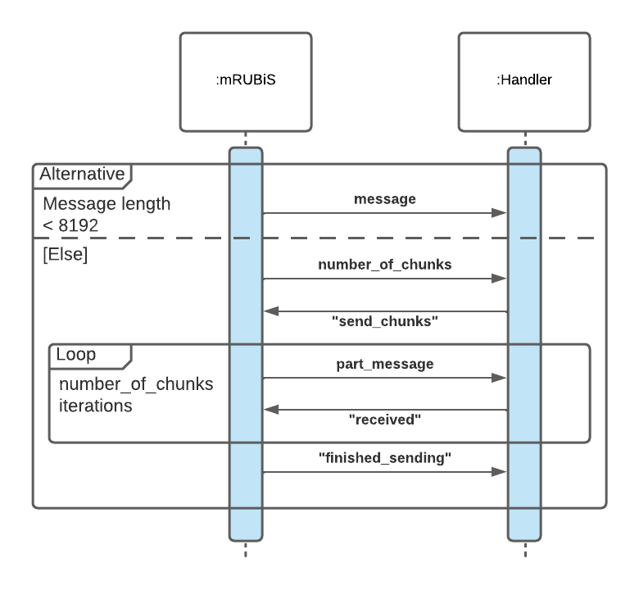
Design Decisions: Communication
Decision: Send state in one message instead of many small ones
Issue: Character limit on socket
Solution: Chunked communication
Notes:
Florence
What changed for communication?
Here I would problematize it first. What was the problem with previous communication mechanism that would make it suboptimal for multi-agent?

Slide 16
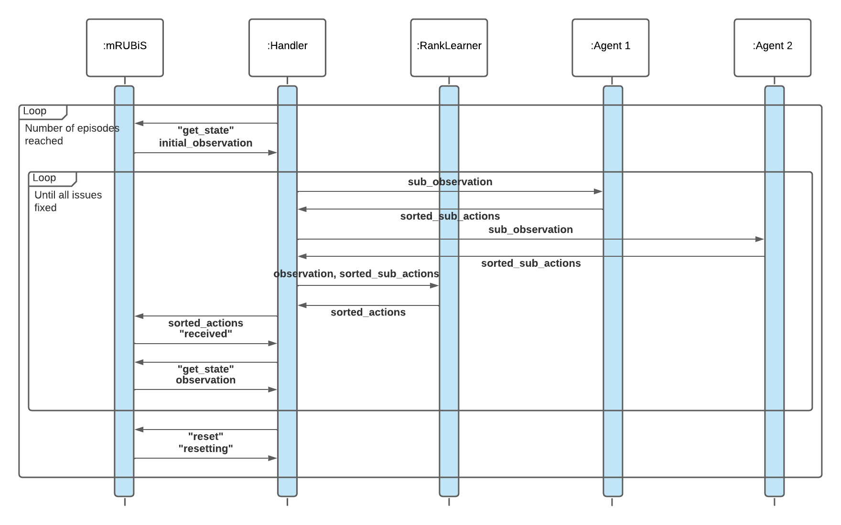
Design Decisions: Communication
Notes:
Florence
What changed for communication?
Here I would problematize it first. What was the problem with previous communication mechanism that would make it suboptimal for multi-agent?

Slide 17
mRUBis Changes
Changes needed to adapt for Multi-Agent Learning with Failure Propagation
Topic | Before | After
Utilities | mRUBiS calculates all component utilities internally | Introduced global state dict for storing utilities
Environment | Environment set once | Environment reset after every run
Multi-Agent-Training | mRUBIS was guaranteed to fix correct components | Introduced inner loop until correct components found
Notes:
Review previous slides from Ulrike and Jonas, but relate to the communication infrastructure.
utils: - needed because we simulate propagated failures with 0 utility
environ: - mrubis utility unstable, also fixes sometimes not applied
training: - update

Slide 18
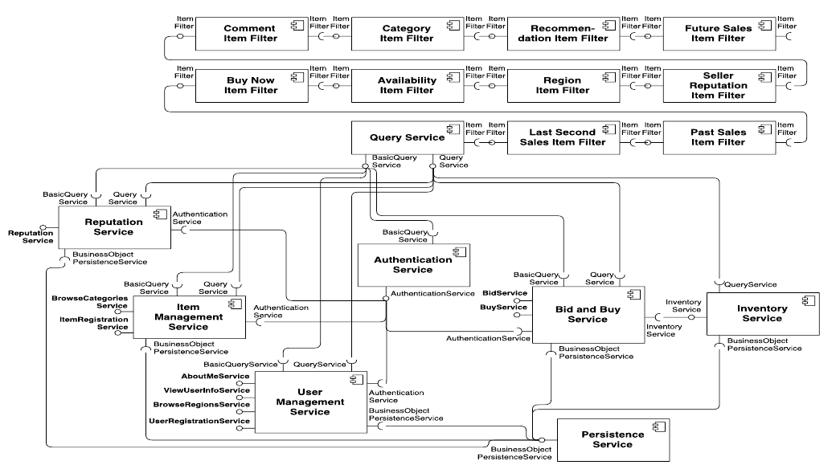
Failure Propagation Example
Notes:
Problematize it as Data Generation Process that sits between the legacy mRubis and the Multi-Agents:
What is the failure propagation?
Why does it matter? Why is it important? (realism + variability/flexibilty)
What were the design challenges and corresponding solutions?

Slide 19
Approach: Multi-Agent Architecture
Mrubis
Multi Agent Architecture
Challenges:
Overfitting
Non-stationary
Two learning goals:
choose correct failing component
rank these components correctly
Self-adaptive controller
Assign agents to tasks
Monitor behavior
Re-assign on breaches
Mrubis Environment
Multi Agent Controller
Agent
Agent
Agent
Agent
Notes:
two layers: utility + ranking
overfitting problem -> robustness by mac
self-adapting: monitoring and reacting to changes
+ non-stationary problem (hard b/c marl -> solve this by monitoring)

Slide 20
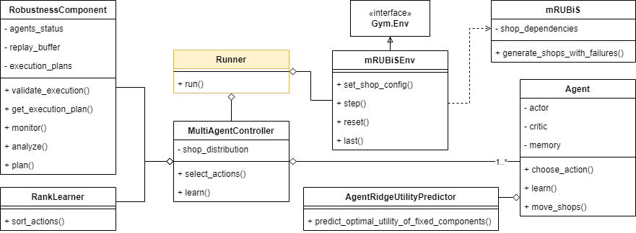
Approach: Multi-Agent Architecture
Implementation

Slide 21
Approach: Multi-Agent Architecture
Implementation
Hierarchical Learning Structure
Coordinator:
MultiAgentController coordinates observations, actions and rewards and breaks problems into subproblems
Learning Goals:
(L1) Agents solve low-level problem of fixing their shops using an actor-critic method
(L2) RankLearner uses predicted utility of ridge regression to sort fixes for sequential mRUBiS
Mrubis Environment
Multi Agent Controller
Agent
Agent
Agent
Agent
Notes:
explain hierarchical rl
how to define policy, reward. how to train
Another slide: Our entities matched with the general approach

Slide 22
Approach: Multi-Agent Architecture
Implementation

Slide 23
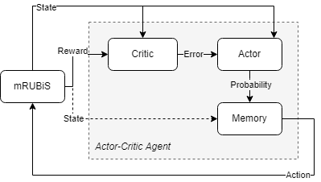
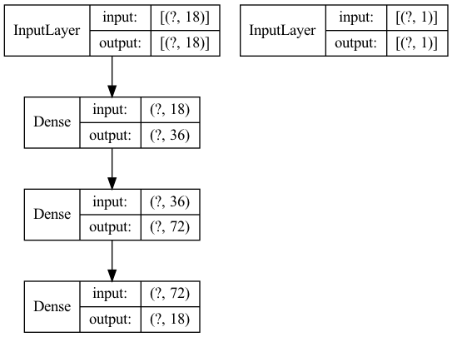
Approach: Multi-Agent Architecture
Implementation: Actor-Critic Agent
Based on the policy gradient theorem [Sutton and Barto, 2018]
Memory extension to prevent the same mistakes
Mrubis Environment
Multi Agent Controller
Agent
Agent
Agent
Agent
Notes:
policy gradient theorem. The
theorem implies learning a policy for selecting actions without the
need for a value function.

Slide 24
Approach: Multi-Agent Architecture
Implementation
Mrubis Environment
Multi Agent Controller
Agent
Agent
Agent
Agent

Slide 25
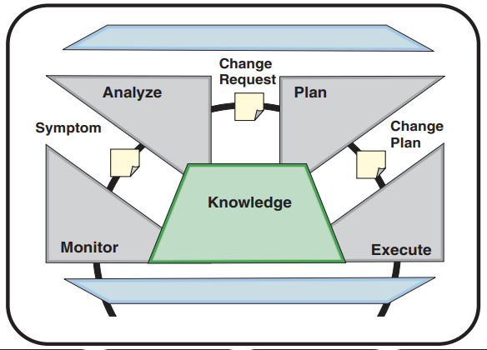
Approach: Multi-Agent Architecture
Implementation: Robustness
MAPE-K [Arcaini, 2015]
Mrubis Environment
Analysis: Detect breaches of defined thresholds
Plan: Rank agents transfer challenges
Multi Agent Controller
Agent
Agent
Agent
Agent
Monitor: history, agent metrics & and counters
Execute: Execute challenge & overtake shops or retrain
Knowledge: States & weights of agents
[Kephart, 2003]

Slide 26
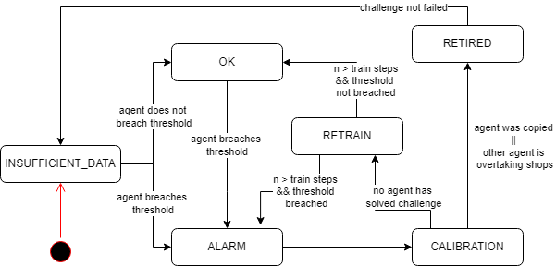
Approach: Multi-Agent Architecture
Implementation: Robustness
Mrubis Environment
Multi Agent Controller
Agent
Agent
Agent
Agent

Slide 27
Experiments

Slide 28
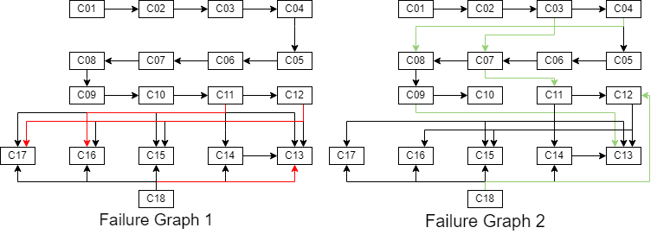
Evaluation: MAPE-K Robustness
Experimental Design
Simulating the behavioral contagion effect across shops

Slide 29
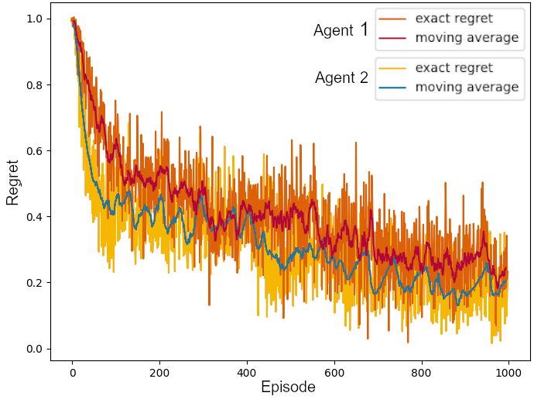
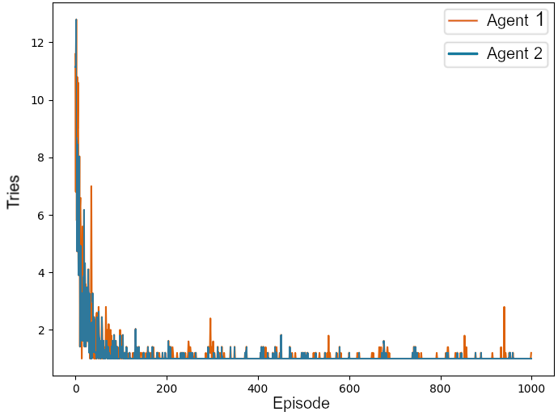
Evaluation: MAPE-K Robustness
Experimental Design
Phase 1:
Train agents on 2 different failure graphs individually
Phase 2:
Train both agents on same system with failure graph 2

Slide 30
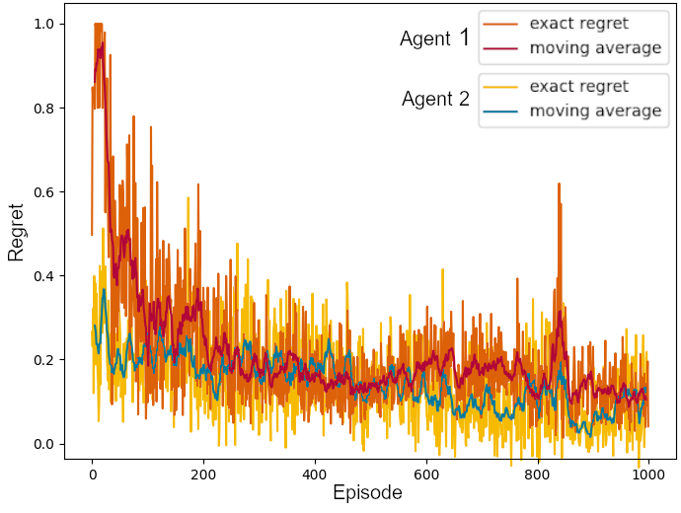
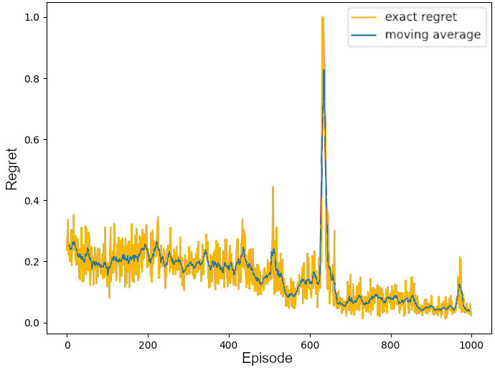
Evaluation: MAPE-K Robustness
Results
Without Robustness
With Robustness
Notes:
Baseline shows convergence is not reached after 1000 episodes
Agent 1 reaches same performance as before after 200 episodes of retraining
feedback-loop is reducing the loss drastically

Slide 31
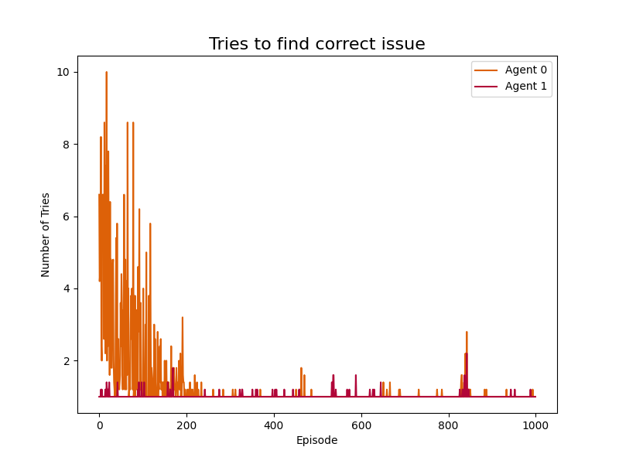
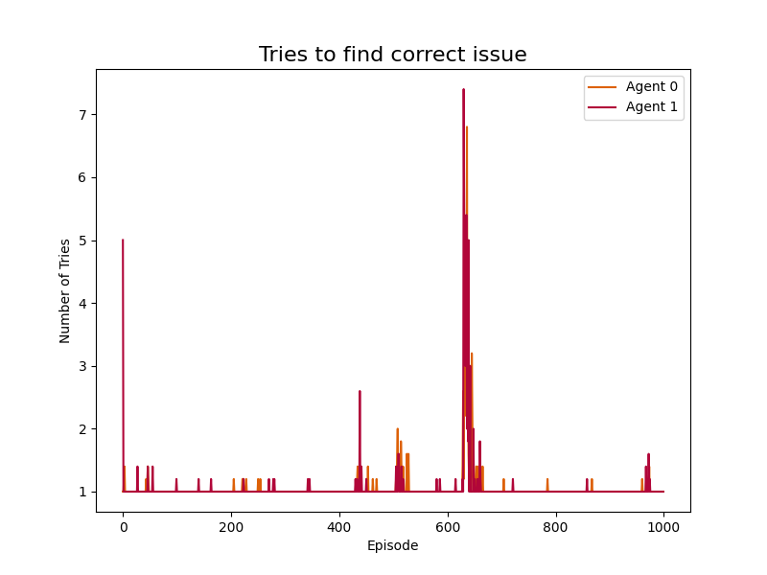
Evaluation: MAPE-K Robustness
Experimental Design
Without Robustness
With Robustness

Slide 32
Evaluation: MAPE-K Robustness
Discussion
Phenomenon of spreading or recurring changes must exist
are present in (at least) human-driven data
e.g. behavioral contagion
stepping stone for further research

Slide 33
Trace Robustness - Experimental Design
Test how robust the agents are to changes in the environment
Changes correspond to lengths of traces that the agent never saw
during training
Phase 1:
Train agents on different train sizes till convergence
Phase 2:
Test agents on different sized traces

Slide 34
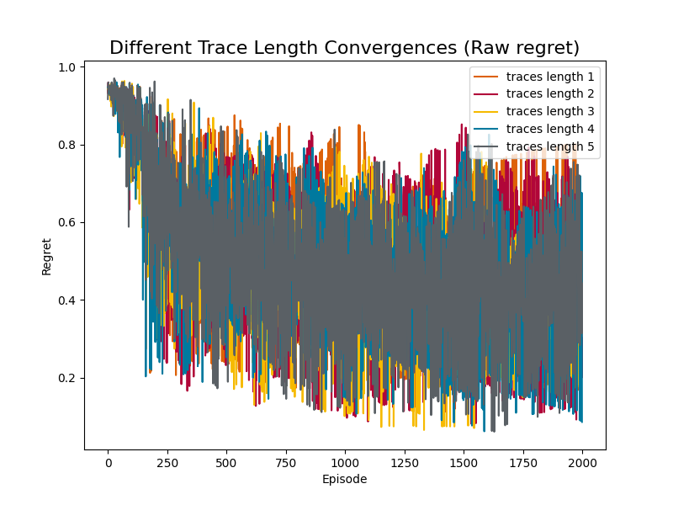
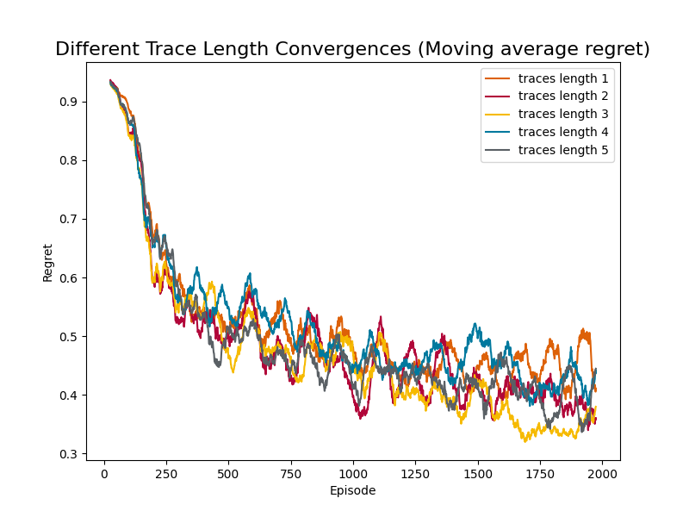
Trace Robustness - Experiment
Notes:
values jump a lot
-

Slide 35
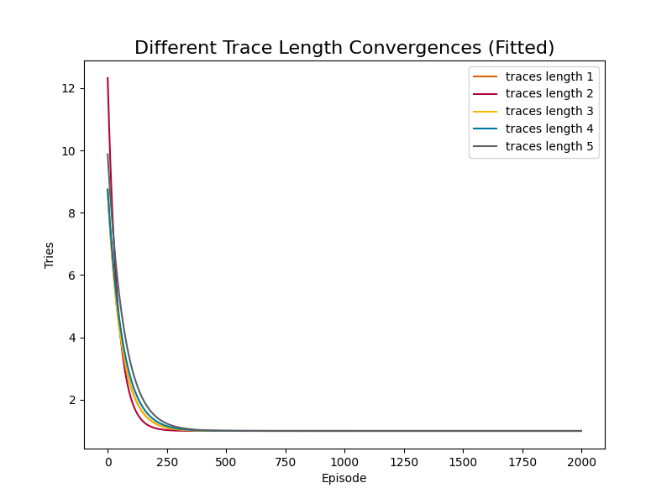
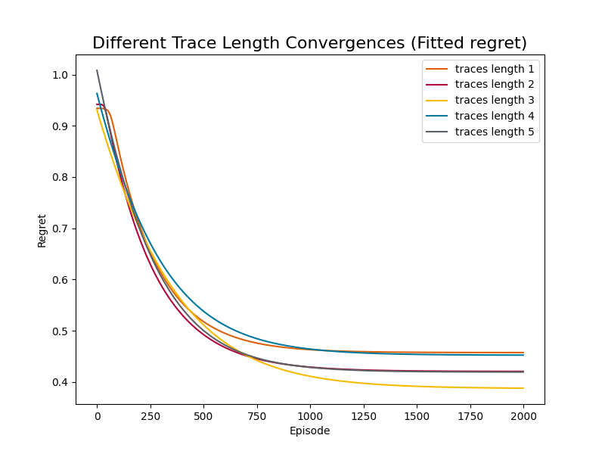
Trace Robustness - Experiment
Notes:
fitted to an exponential function we can see the convergence better
left side tries
where do we converge to?
why the difference values we converge to?

Slide 36
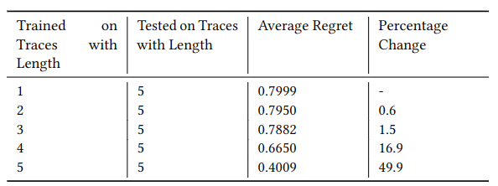
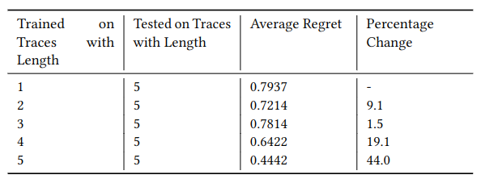
Trace Robustness - Experiment
Best Model
Not converged
Notes:
2 models
no diminishing returns
agent doesnt learn architecture of shop dependencies
more generalisble model performs a little bit better

Slide 37
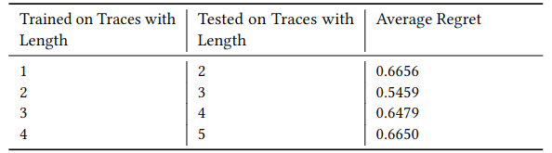
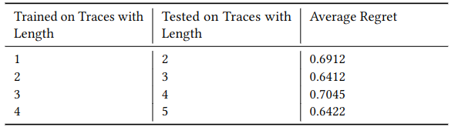
Trace Robustness - Experiment
Best Model
Not converged

Slide 38
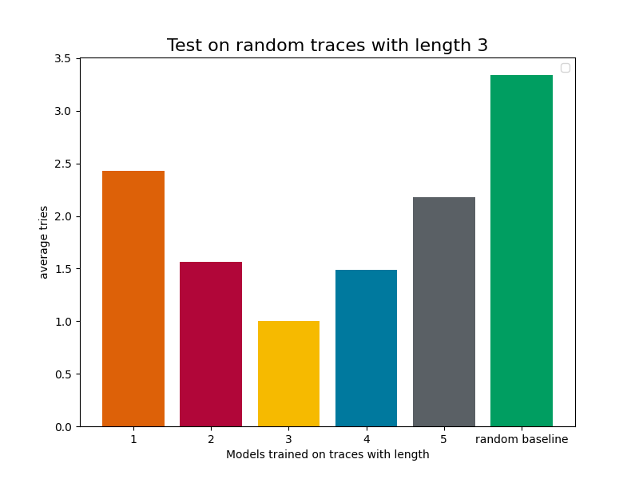
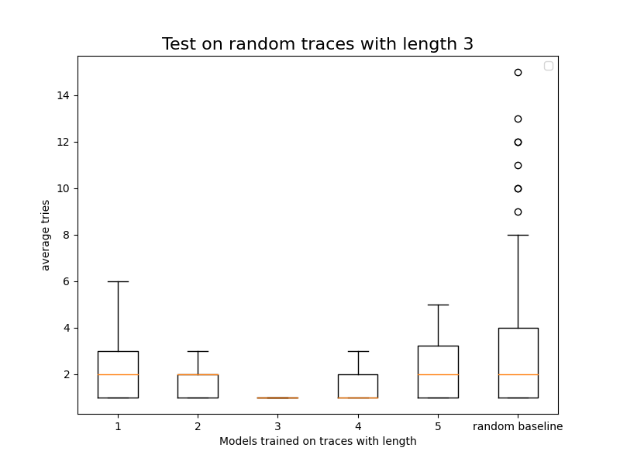
Trace Robustness - Experiment

Slide 39
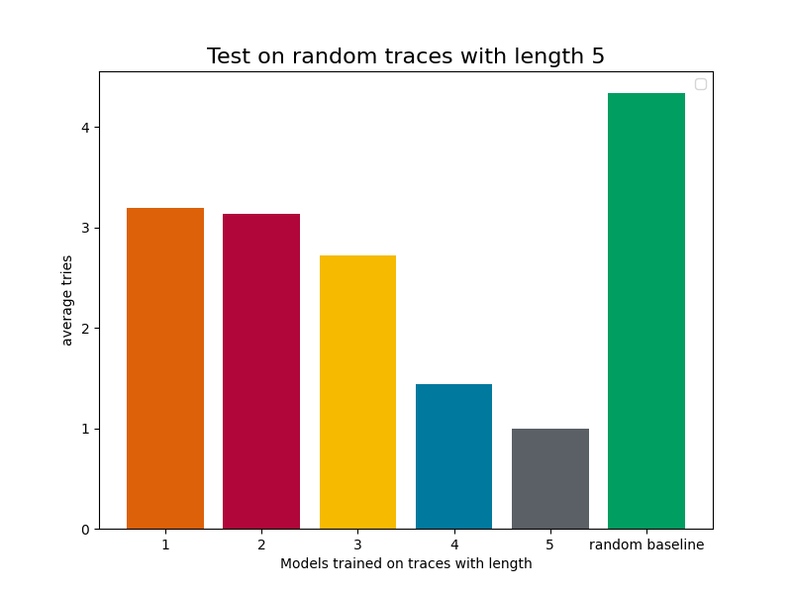
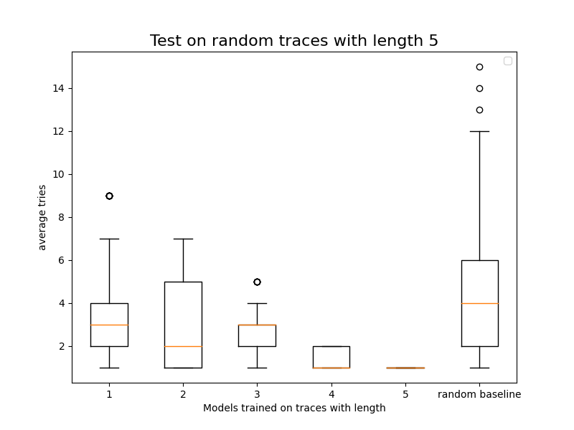
Trace Robustness - Experiment

Slide 40
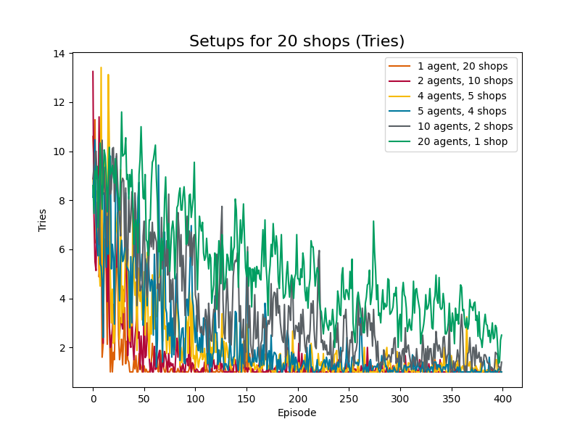
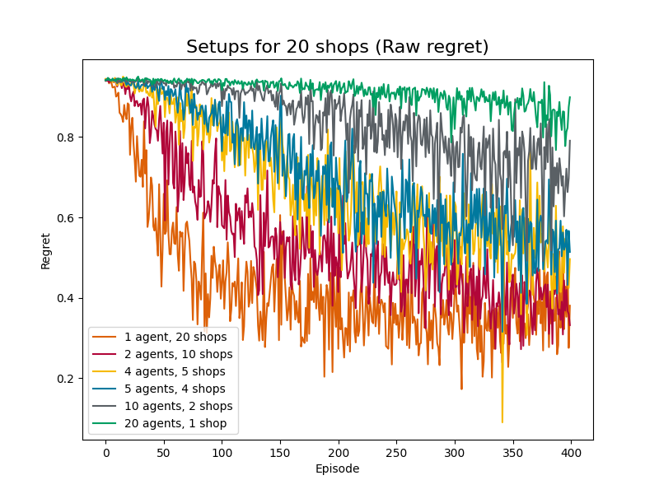
Scalability - Experimental Design
Gather both tries and regret data for multiple different shop-agent-setups
Here: Constant number of total shops, different agent distributions among them

Slide 41
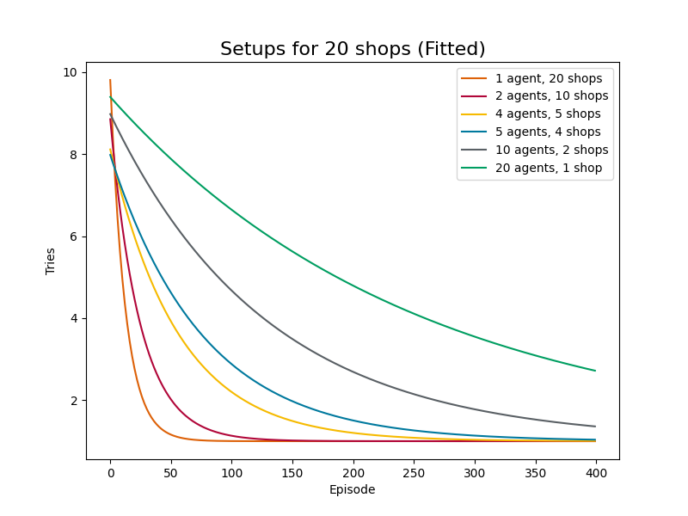
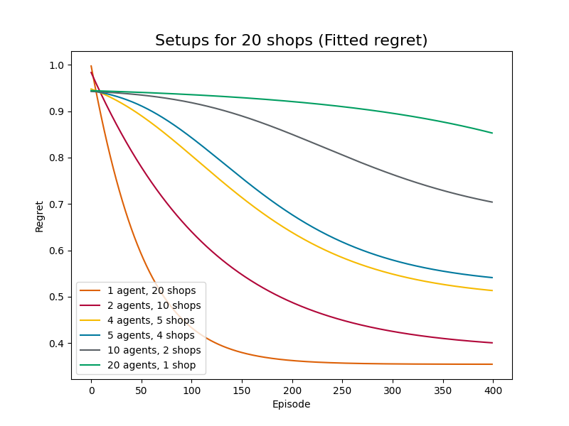
Scalability - Experimental Design
Fit exponential (tries) and generalized logistic (regret) functions to the data
Logistic function can represent exponential-like curves if needed

Slide 42
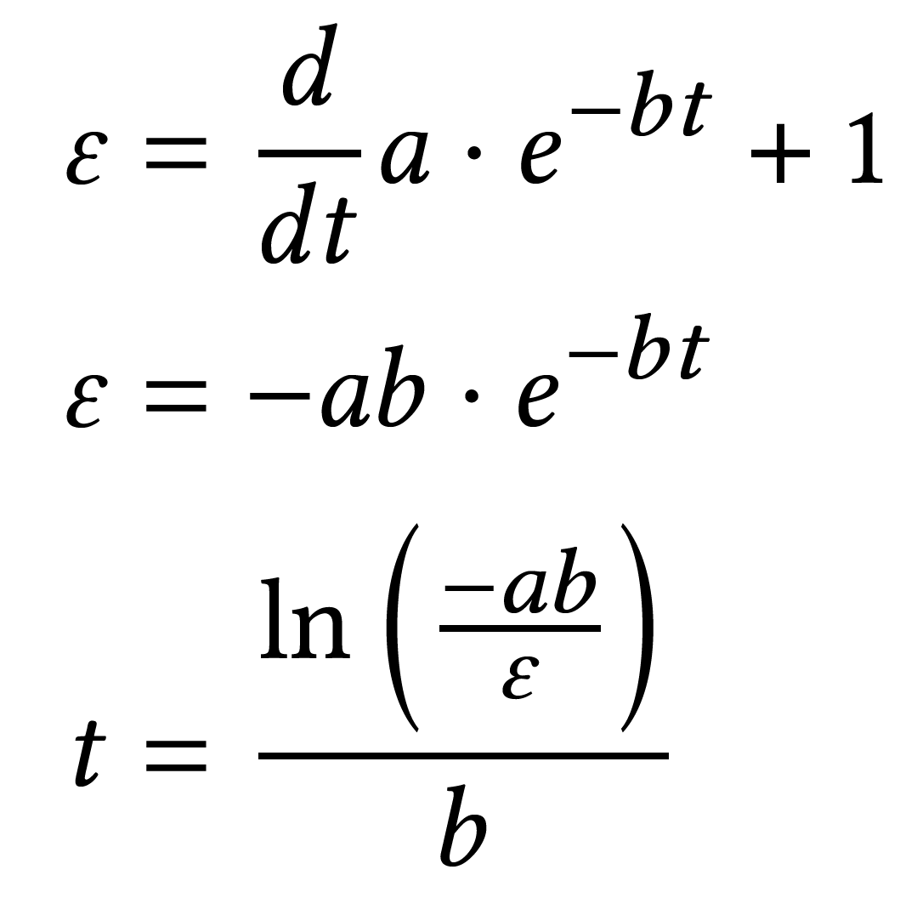
Scalability - Experimental Design
Determine convergence point by determining the episode when tries derivative reaches a certain value (it never reaches 0, but it approaches it asymptotically)
Outliers: Relative frequency of outliers in the tries post-convergence

Slide 43
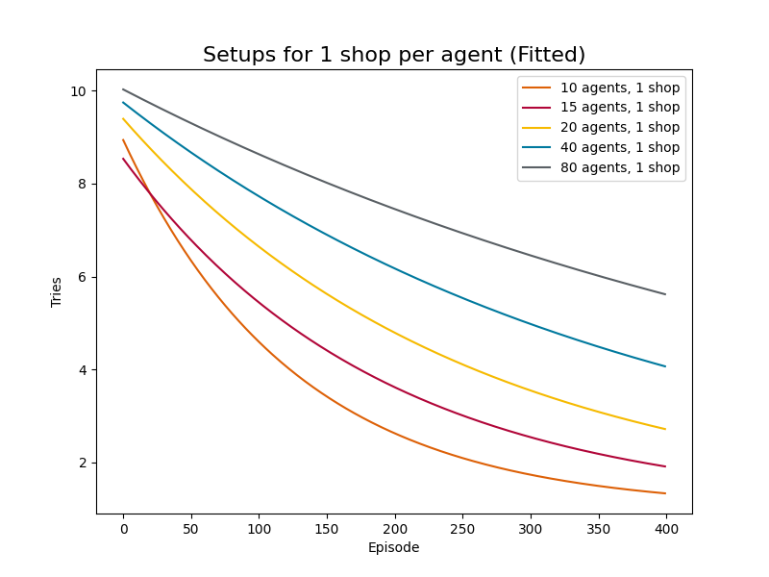
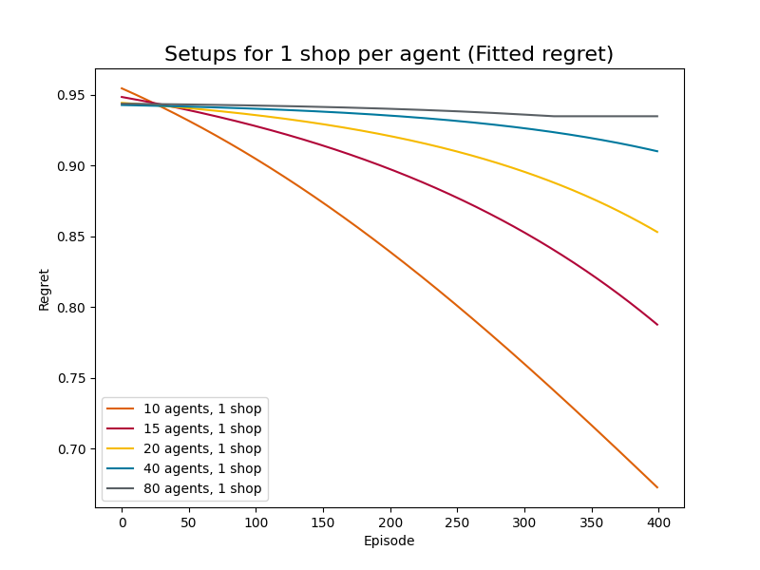
Scalability - Experiments

Slide 44
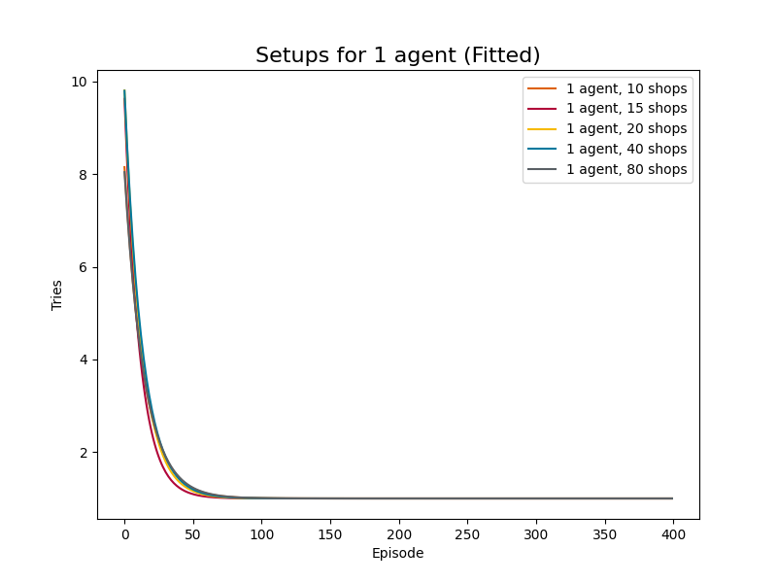
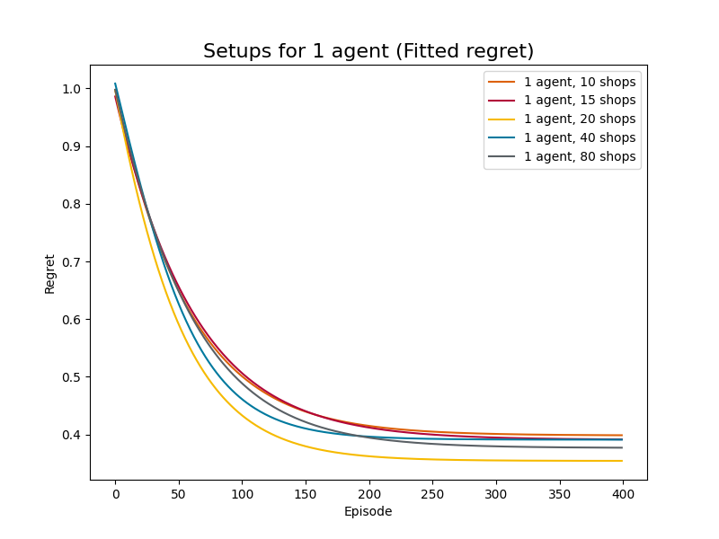
Scalability - Experiments

Slide 45
Scalability - Discussion
Adding more agents for a fixed number of shops decreases performance in both tries and regret
For a given number of shops per agent, adding more shops decreases performance in both tries and regret
Performance is related to the total number of agents, as that influences the relative amount of data that each agent receives
For a given number of agents: Best convergence/outlier data for 10-15 shops per agent, best regret data for 20 shops per agent

Slide 46
Threats to Validity

Slide 47
Threats to Validity
External and Internal
External validity:
minimized risk of favoring components by randomly inject failures
failure traces were restricted by mRUBiS architecture
Internal validity:
mitigated risk of confounding by controlled experiments, e.g., trace size, number of shops
Notes:
add github future work topics

Slide 48
Threats to Validity
Construct and Conclusion
Construct validity:
used smoothness techniques and derived formulations that allowed unambiguously to compute convergence points, outliers, and minimum regret
Conclusion validity:
we did not solely rely on the average regret, but also on the convergence of tries
Notes:
add github future work topics

Slide 49
Extensions

Slide 50
Extensions
Improvements
Multi-Armed Bandits Approach
Neural Network-Based Detection of Underperformance
Data Generative Process for Utility
Notes:
add github future work topics

Slide 51
Extensions
Relaxation of Assumptions
Asynchronous Failure Injection
Non-stationary Utility
Multi-Failure Phenomenon
Perfect Failure Masking Phenomenon
Notes:
add github future work topics

Slide 52
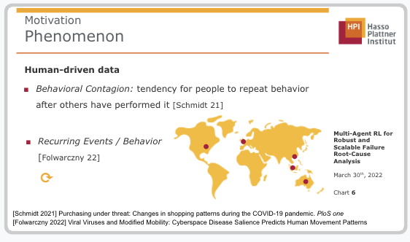
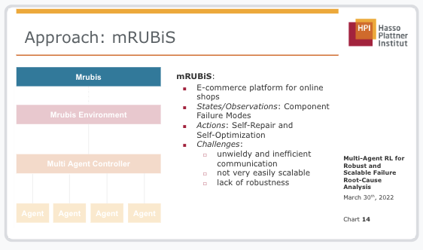
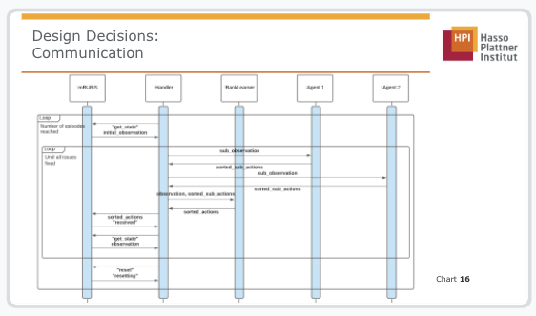
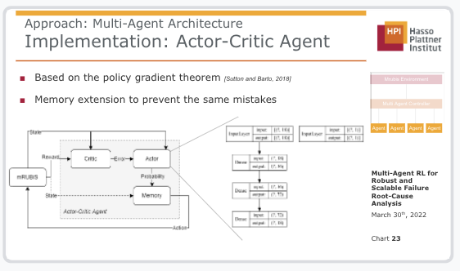
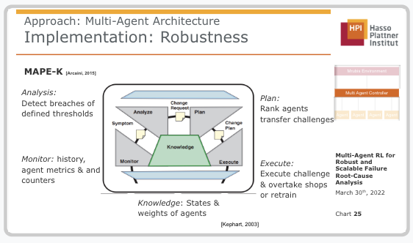
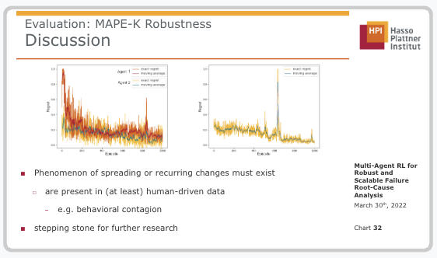
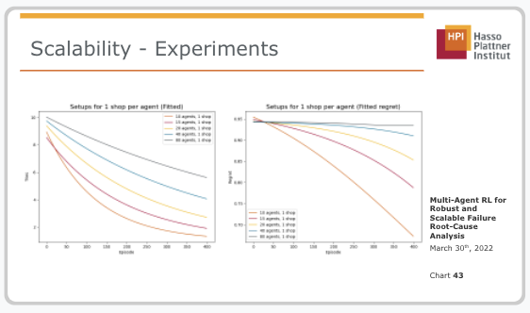
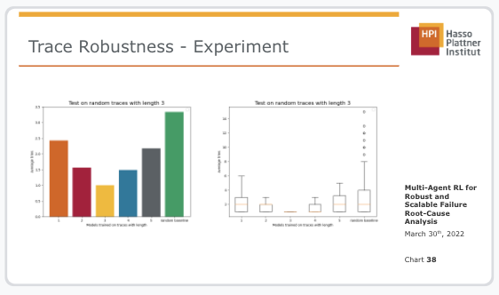
Conclusion
Notes:
MAPE-K robustness:
MAPE-K feedback-loop improves robustness for rolling updates following the behavioral contagion effect.
The loss is reduced drastically as underperformance is detected, shops are moved and retraining is prevented.
The scenario is at the moment rather strict but could be more relaxed by implementing the presented possible extension to (1) relax the assumptions (2) improve the multi-agent architecture.
trace robustness:
Agents are robust to changes in the trace length, but there is still room left for improvement
e.g. by modeling the architecture seperately
also different models and reward mechanisms could be tested to improve regret
Scalability:
Regret is more granular than tries, but tries more directly measure performance
Number of total agents is most important factor for performance: Fewer total agents perform better within our data range
If we have fixed number of agents, ~10-20 shops per agent performs best

Slide 53
Thank you for your attention!
February 4th, 2022
Robust Multi-Agent RL for Self-Adaptive Systems

Slide 54
References
[Ahilan, 2019] Ahilan & Dayan, 2019: Feudal Multi-Agent Hierarchies for Cooperative Reinforcement Learning
[Kong, 2017] Kong et al, 2017: Revisiting the Master-Slave Architecture in Multi-Agent Deep Reinforcement Learning
[Gronauer, 2021] Gronauer & Diepold, 2021, Multi-agent deep reinforcement learning: a survey
[Arcaini, 2015] P. Arcaini, E. Riccobene and P. Scandurra, "Modeling and Analyzing MAPE-K Feedback Loops for Self-Adaptation," 2015 IEEE/ACM 10th International Symposium on Software Engineering for Adaptive and Self-Managing Systems, 2015, pp. 13-23, doi: 10.1109/SEAMS.2015.10.
[Jordan 2019] M. Jordan et al, “Theoretically principled trade-off between robustness and accuracy”, 2019 International conference on machine learning, pp 7472-7482
[D’Amour et al. 2020] A. D’Amour et al, “Underspecification presents challenges for credibility in modern machine learning”, 2020, doi: 2011.03395
[Sutton and Barto, 2018] Richard S Sutton and Andrew G Barto. 2018. Reinforcement learning: An introduction. MIT press.
[Kephart, 2003] Jeffrey Kephart and D.M. Chess. 2003. The Vision Of Autonomic Computing.Computer 36 (02 2003), 41 – 50. https://doi.org/10.1109/MC.2003.1160055

Slide 55
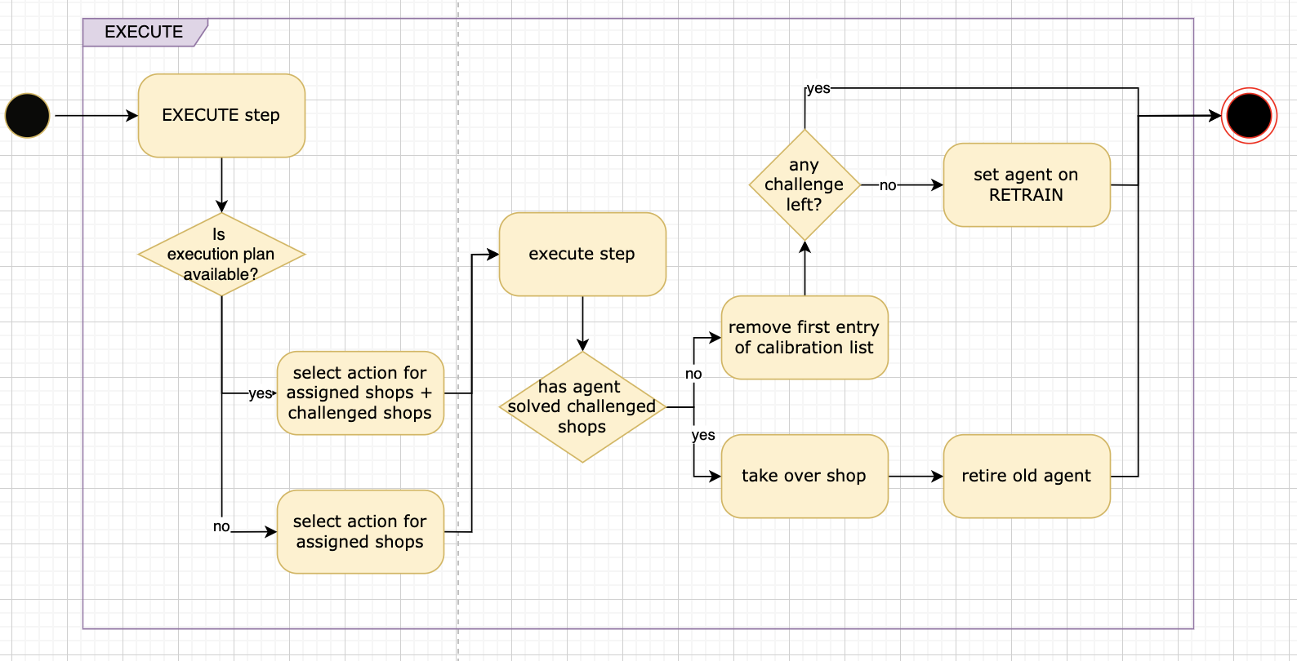
Current Design Decision - Robustness

Slide 56
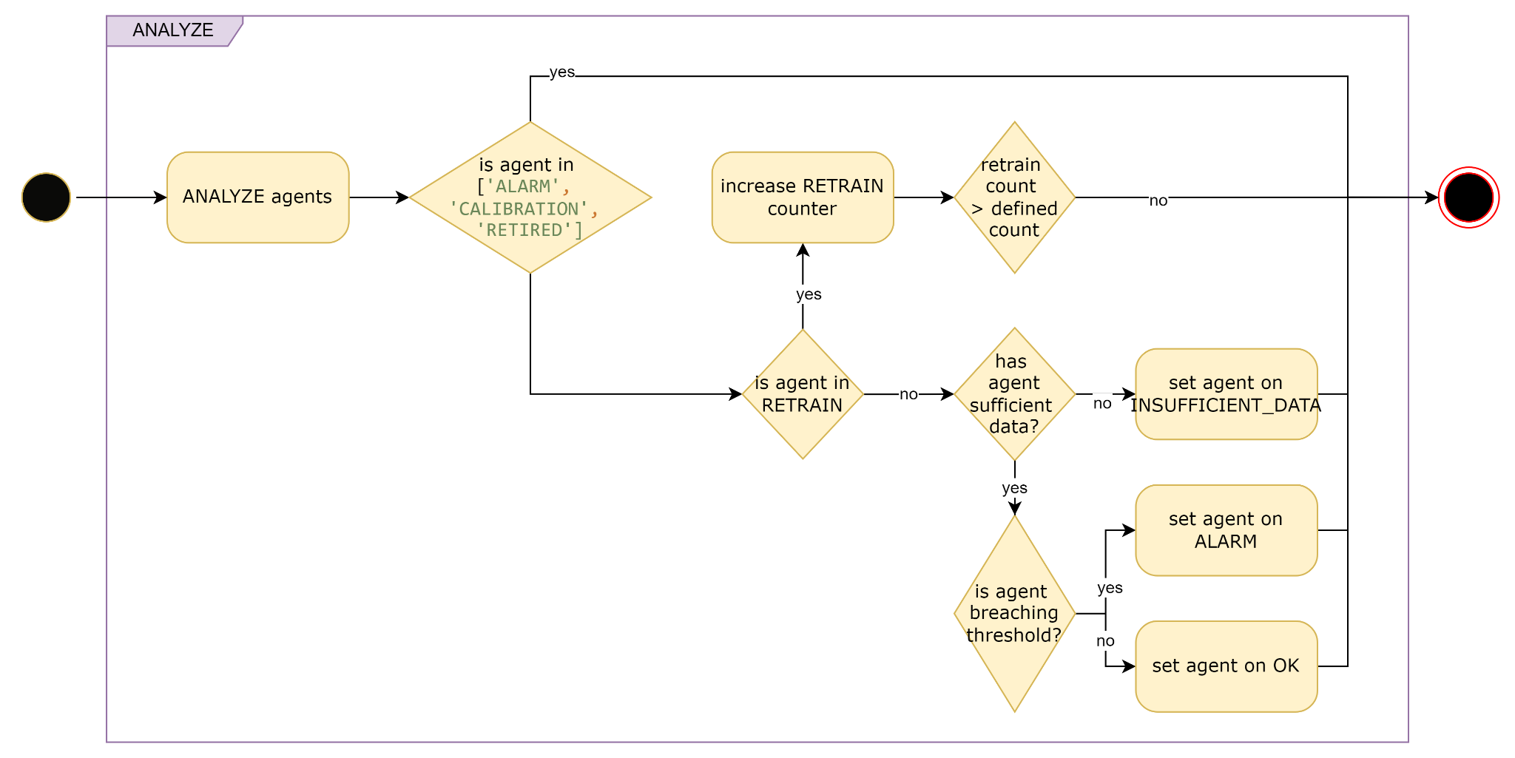
Current Design Decision - Robustness

Slide 57
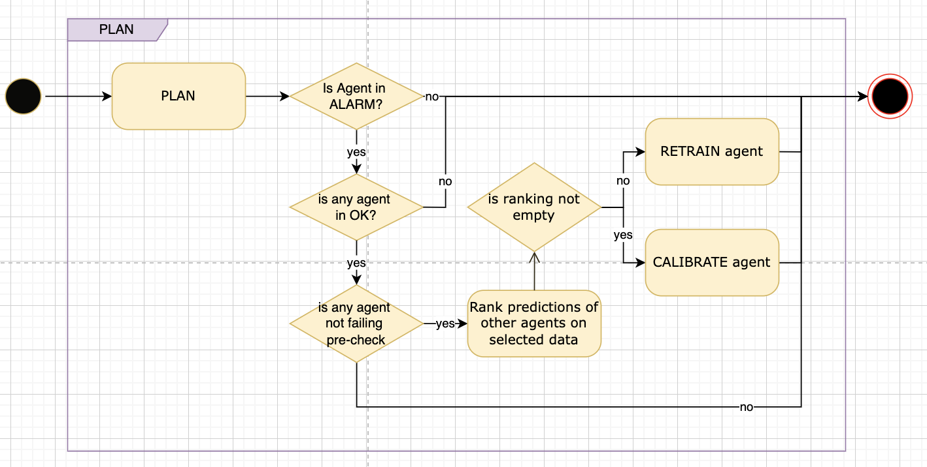
Current Design Decision - Robustness

